Slide 1

Database Theory and Applications for Biomedical Research and Practice
BMIN 502 / EPID 635
Week 9
Introduction to secondary data sources

Slide 2
Sources of data for clinical research
Primary
  Surveys
  Outbreak investigations
  Ongoing research studies
  Registries
Secondary
  Medical records
  Surveys
  Registries
  The US Census
  Insurance claims

Slide 3
Using existing data
Three approaches
  Secondary data analysis
  Ancillary studies
  Systematic reviews
Advantages
  (Relatively) fast data collection
  (Relatively) cheap
Disadvantages
  The main one: Possibly poor quality
    No control over how data were collected
    No control over what data were collected
    No control over when data were collected

Slide 4
Types of datasets for secondary analysis
Individual datasets
  Prior research studies
  Publicly available datasets
  Registries
Aggregate datasets
  Datasets on groups of observation units
  Useful for ecologic studies

Slide 5
Using secondary data:
Discovering a research question to fit the data
Identify an appropriate database
Learn all you can about the data
  Primary documentation: Data dictionaries, use documents, descriptions by source agency
  Secondary documentation: papers, communication with prior users/user groups
Identify variables of interest for your research question
Review the literature and consult with experts
Get the data into the appropriate platform
Perform descriptive analyses and formulate hypotheses
Analyze!

Slide 6
How are secondary data packaged?
Aggregated reports
Flat text files
Spreadsheets
Datasets
Databases
Data warehouses

Slide 7
The data warehouse
A centralized resource for long-term data storage
Supports the activities of entire organizations
Takes input from distributed databases on scheduled batch basis
Provides access to large-scale, temporal data
Provides a platform for decision support

Slide 8
How does a warehouse work?
Data Mart
Data Mart
Data Mart
Database
Database
Data Warehouse
Extract data
Database
Database
Database
Transform data
Load data

Slide 9



A local example: The Penn Research Data Warehouse
Industry
Identified
De-Identified
Phenotype and Limited Genotype Data from Health System Operations
Cohort Identification
Penn Data Store
Precision Medicine Warehouse
PennOmics
Studies
Outcomes
Consents
Clinical Trials
Registries
Bio-banks
‘Omics
‘Omics
Samples
Protocols
Search /Analytics
“Cohort Explorer”
Research Data
Tumors
Subjects / Patients
Treatment
Penn Researchers and Clinicians
Discrete Data Only

Slide 10
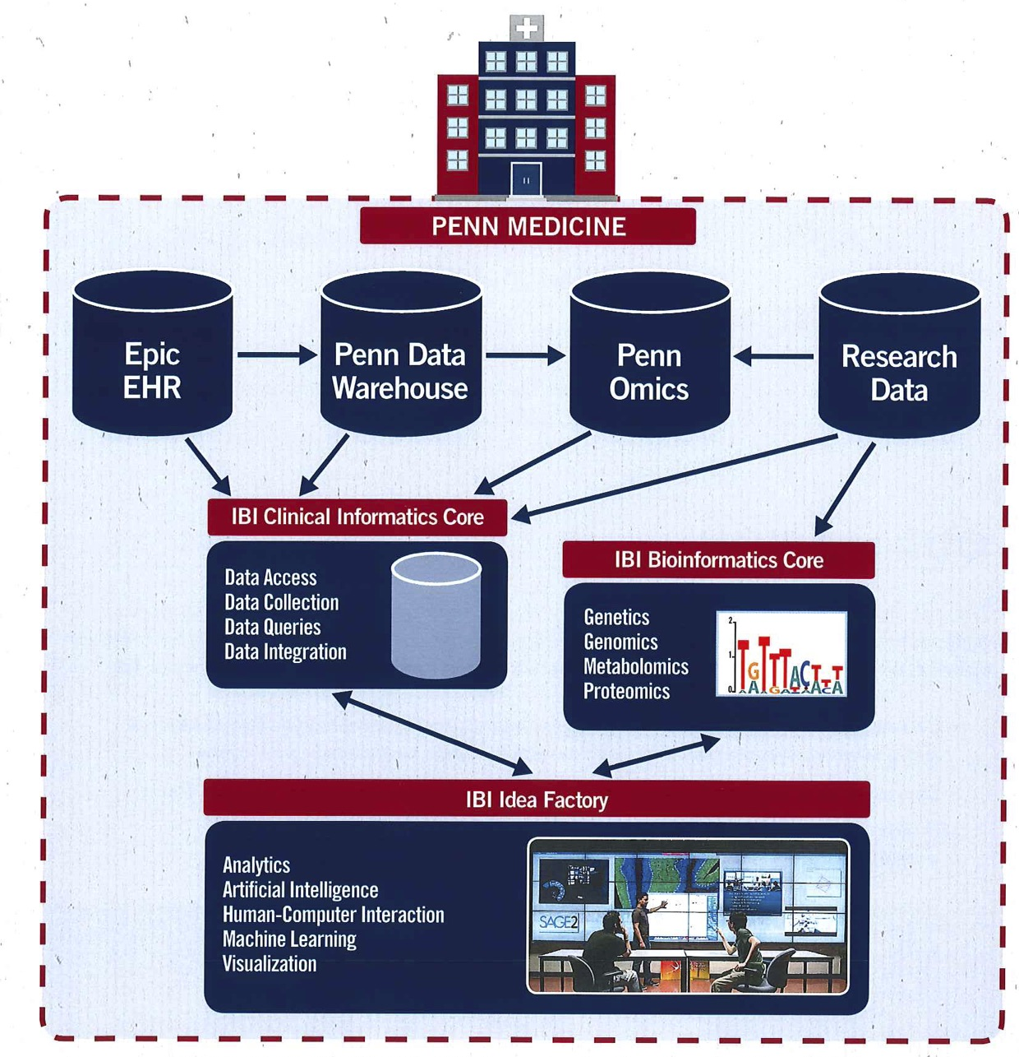
An integrated informatics ecosystem

Slide 11
Some secondary data resources worth considering
Bureau of the Census
National Center for Health Statistics
National Cancer Institute
Agency for Healthcare Research and Quality

Slide 12
The Census:
First things first…
What is a census?
  Enumeration, not a sample
Characteristics of the US Census
  Performed every 10 years
  Census (everyone)
    Short form
  Sample
    Long form

Slide 13
American Community Survey
Collects data on ~3M American households yearly
Sample drawn from every US county
Supports “critical government functions”
Will eliminate the decennial long form

Slide 14
Population Estimates Program
Population estimates between censuses
Four waves each year:
  Winter - The United States and States
  Spring - Counties
  Summer - Cities and Towns
  Fall - Metropolitan and Micropolitan Statistical Areas
Estimates refer to population as of July 1 of previous year

Slide 15
Other surveys at census.gov
Survey of Income and Program Participation (SIPP)
  Evaluation of government programs
Current Population Survey (CPS)
  50K households/month
  Development of government programs
American Housing Survey (AHS)
  Biennial sample of ~55K households (repetitive)
  Data on housing characteristics and household flow
And numerous others for other government agencies…

Slide 16
How to get into the Census http://www.census.gov/

Slide 17
How about the CDC?
National Center for Health Statistics

Slide 18
A few of the data systems at the
CDC National Center for Health Statistics http://www.cdc.gov/nchs/surveys.htm
Vital Statistics System
National Immunization Survey
National Health Interview Survey
National Health Care Survey
Behavioral Risk Factor Surveillance System
National Health and Nutrition Examination Survey

Slide 19
National Cancer Institute
Surveillance, Epidemiology, and End Results (SEER) Program
Authoritative source of information on cancer incidence and survival in the United States
Started in 1973
Only source of population-based historical as well as current information on patient survival and stage of disease
Data from 20 cancer registries covering about 26 percent of the US population

Slide 20
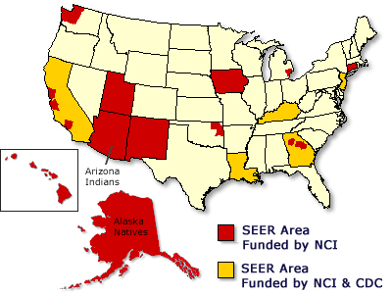
SEER registry coverage http://seer.cancer.gov/registries/

Slide 21
SEER data
Patient demographics
Primary tumor site
Tumor morphology and stage at diagnosis
First course of treatment
Follow-up for vital status
Full data documentation is at: http://seer.cancer.gov/data/documentation.html

Slide 22
SEER public use data http://seer.cancer.gov/resources/
Available for 1973-2010
Requires signed data use agreement
  Renewable annually
Two forms
  Online (SEER*Stat)
  Downloadable or CD with/without SEER*Stat

Slide 23
Agency for Healthcare Research and Quality
Healthcare Cost and Utilization Project (HCUP)

Slide 24
HCUP Databases http://www.ahrq.gov/research/data/hcup/index.html
The Nationwide Inpatient Sample (NIS)
  Inpatient data from a national sample of over 1,000 hospitals
Kids' Inpatient Database (KID)
  Nationwide sample of pediatric inpatient discharges
State Inpatient Databases (SID)
  Universe of inpatient discharge abstracts from participating states
The State Ambulatory Surgery Databases (SASD)
  Data from ambulatory care encounters from hospital-affiliated and sometimes freestanding ambulatory surgery sites
State Emergency Department Databases (SEDD)
  Data from hospital-affiliated emergency departments for visits that do not result in hospitalizations.

Slide 25
Penn has a nice data archive! http://guides.library.upenn.edu/content.php?pid=355474&sid=2907109
Census data
Federal statistics
Maps and GIS data
Data and software tutorials
Links to external data sources

